Slide 1
Capstone Project - 1 Exploratory Data Analysis Hotel Booking Analysis
Ashish Wasnik

Slide 2
Contents :
Introduction
Data exploration
Data cleaning
Types of hotel
Cancellation rate
Deposit policies
Bookings
Customer segmentation
Preferences
Meals
Room Type
car parking
Guests from different countries
ADR and Corelation Heat map
Conclusion
References

Slide 3
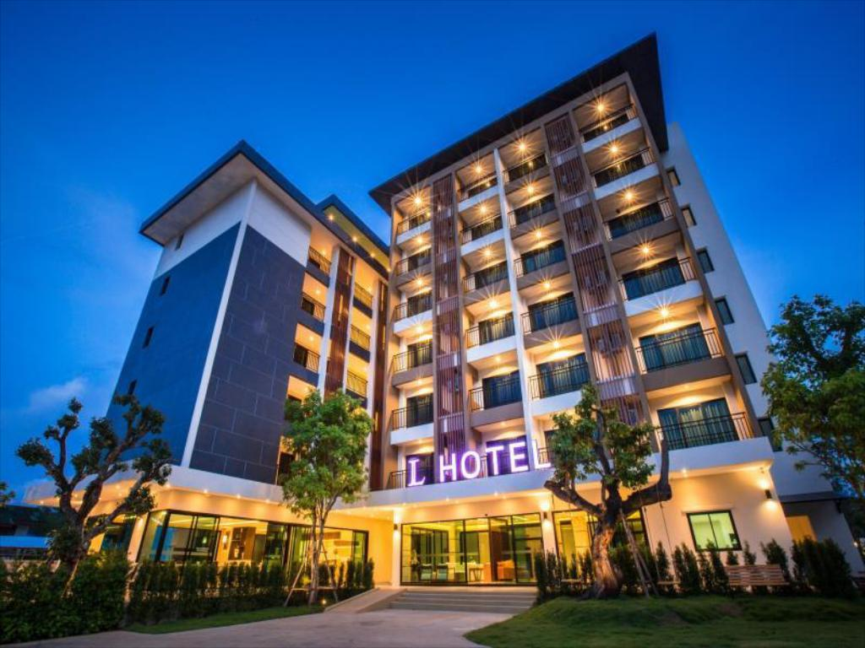
Hotel Industry
The Hotel Industry is one of the most important components within the service industry, catering for customers who require overnight accommodation.
It is closely associated with the travel industry and the hospitality industry, although there are notable differences in scope.
Overall, sales from hotel accounts 87.4% of industry revenue (in India 53.9% and 8% total employment rate).

Slide 4
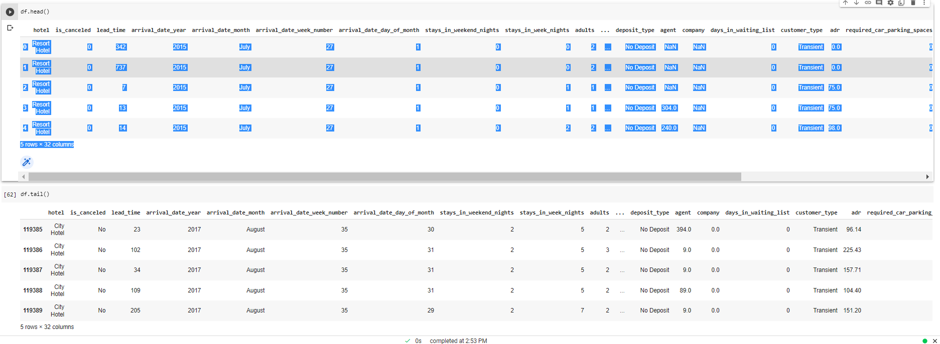
Exploring the Dataset

Slide 5
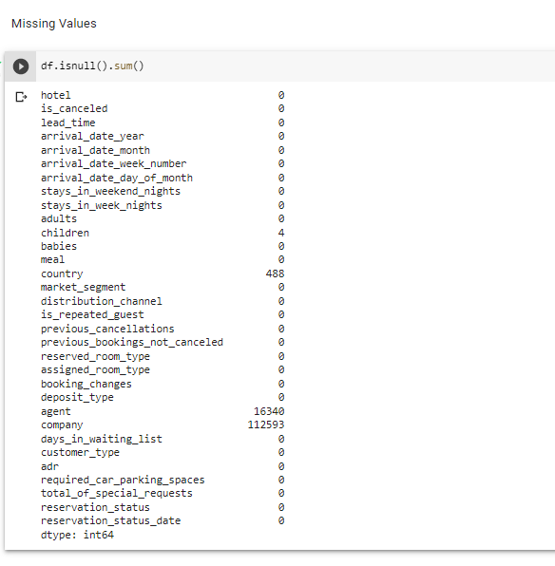
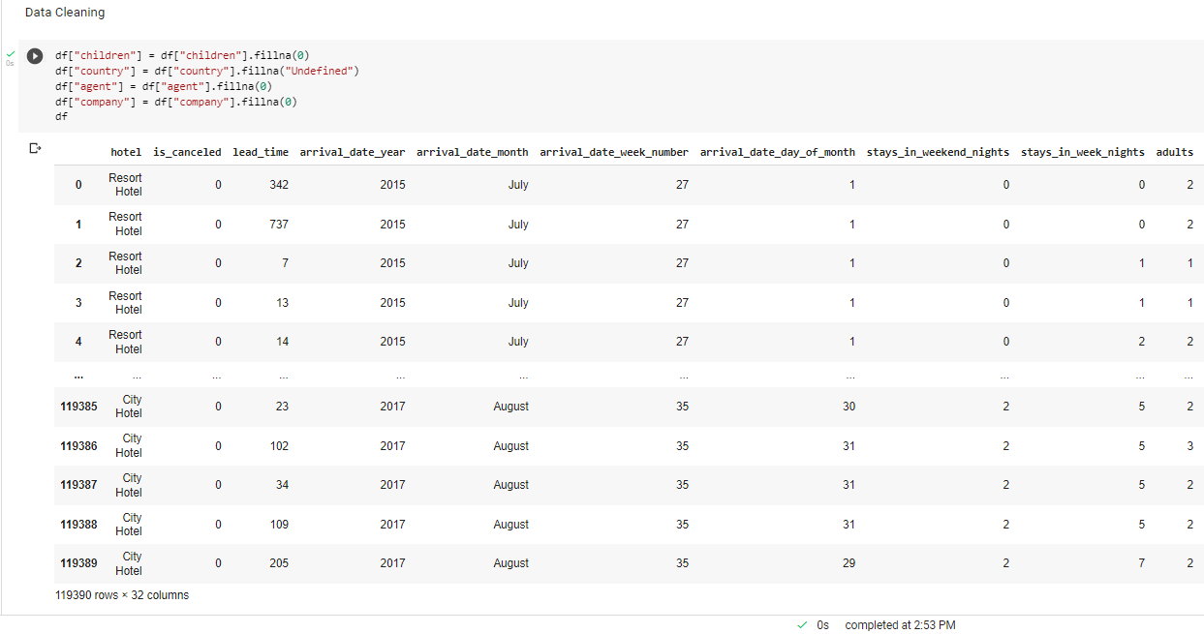
Checking and replacing the Null Values

Slide 6
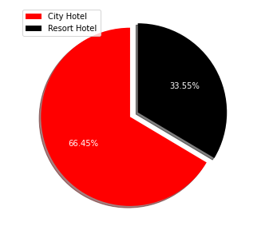
City Hotel and Resort Hotel
It is Observed that City Hotel has more number of bookings compared to Resort Hotel.
The obvious assumption for this trend would be because of monetary reasons.
City hotels would be more affordable than resort hotels due to accessibility, reliability and lavishing factors.

Slide 7
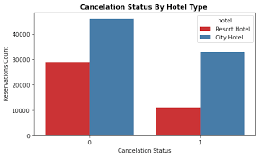
Cancelled Bookings
It is Observed that out of 119390 bookings made, 75166 of them have checked in and 44224 of them has cancelled their bookings.
In percentage, it is about 63% of check-in bookings and 37% of bookings were cancelled.
High cancellation rate will adversely effect the hotel industry which reduces the yield of profit.

Slide 8
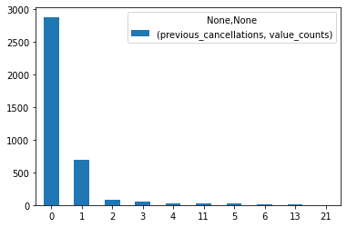
Number of Booking cancelled by the same customers repeatedly

Slide 9
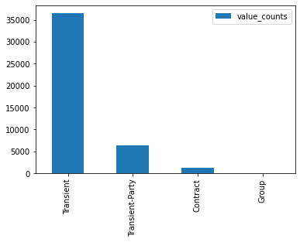
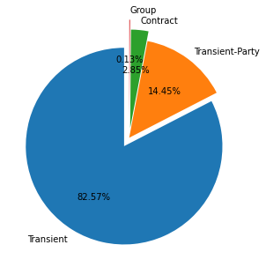
It is observed that, Transient customers are more likely to cancel the booking.

Slide 10
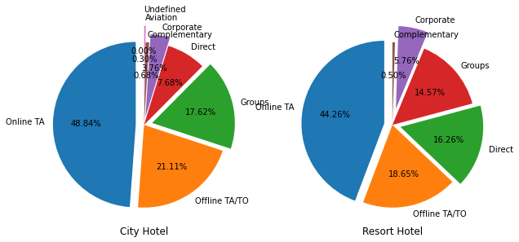
Total Number of Customers across Various Market Segments
Online Travel agency segment gives the high amount of leads for the hotel booking than that of any other sources of Marketsegments.
We can report that we need to target our marketing area on online TA websites or apps and focus majorly on online TA.
The following majority market segments are offline travel agencies, groups and direct customers.

Slide 11
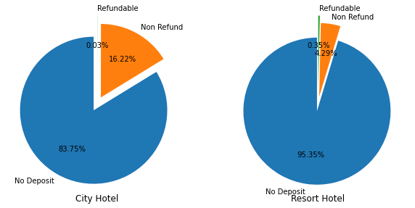
Deposit Policies of Hotel
Most number of the hotel bookings are made in ‘No Deposit, type of transaction which is the reason for the high cancelation rate.
‘No Deposit’ type of transaction means without paying any advance money for the booking.
In order to reduce the cancelation rate, we need to find suitable alternative for the ‘No Deposit’ type of transaction.

Slide 12
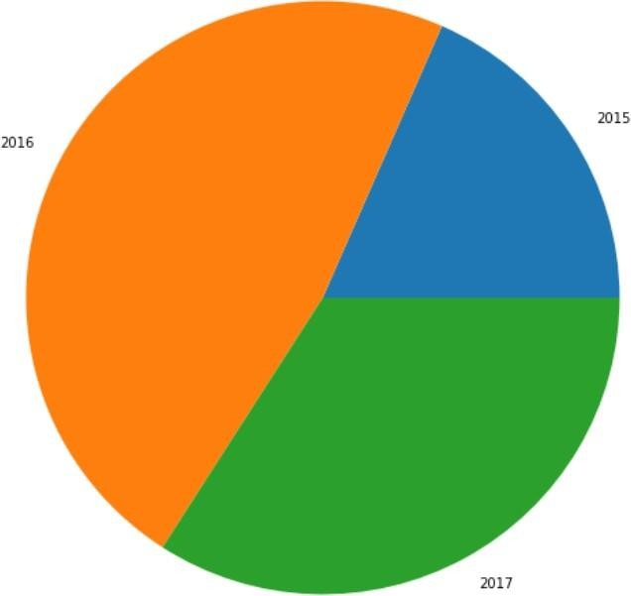
Number of Bookings Across Different Years
Most Number of the bookings are done in the year 2016 following 2017 and 2015 for the dataset given comprising the data for these 3 years.
When, sub plotted, we can see that City hotel has high demand rather than Resort hotels due to its reliability and price difference compared to resort hotels.

Slide 13
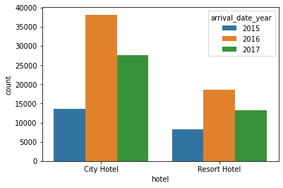
Number of Bookings Across Different Years

Slide 14
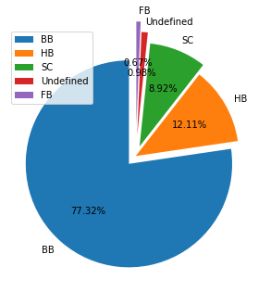
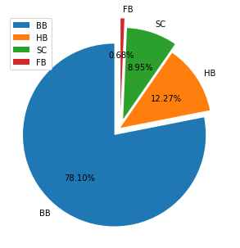
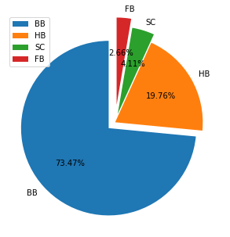
Meals preference
As per the above Graph, we can conclude that guests for BB (i.e. Bed & Breakfast) is more than others i.e. Half Board(HB), Full Board(FB), Self Catering(SC)

Slide 15
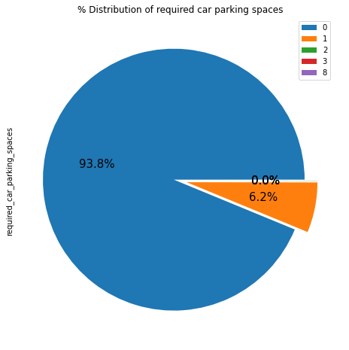
Car Parking Space Analysis
Most of the hotels have zero car space parking.
Among which have car space parking has one car spacing and the trend decreases drastically as number of car spacing increases.

Slide 16
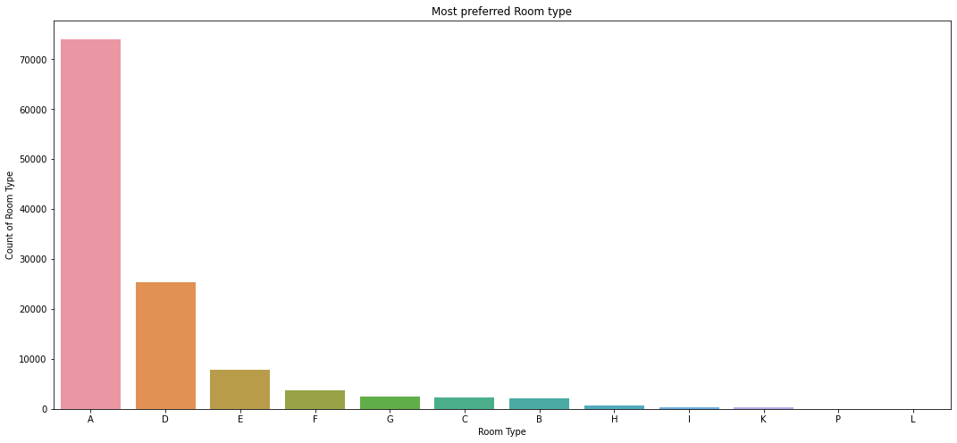
Preferred room type by guests : Maximum number of guest Preferred ‘A’ type rooms.

Slide 17

Top 10 Countries with highest number of Bookings
After analyzing the dataset, we found that Portugal tops the position with 48590 customers followed by UK with 12129, France with 10415, Spain with 8568 and Germany with 7287 customers.
Netherlands sits back with least number of customers among the top 10Countries.

Slide 18
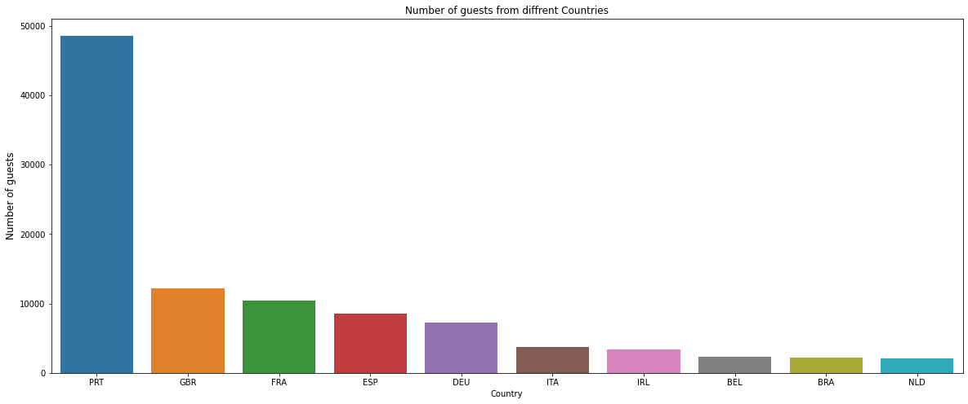
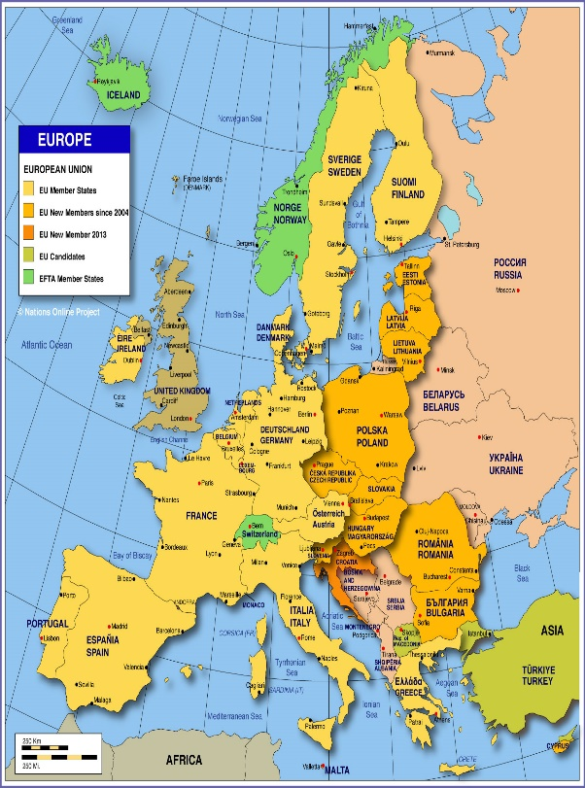
Top 10 Countries with highest number ofBookings

Slide 19
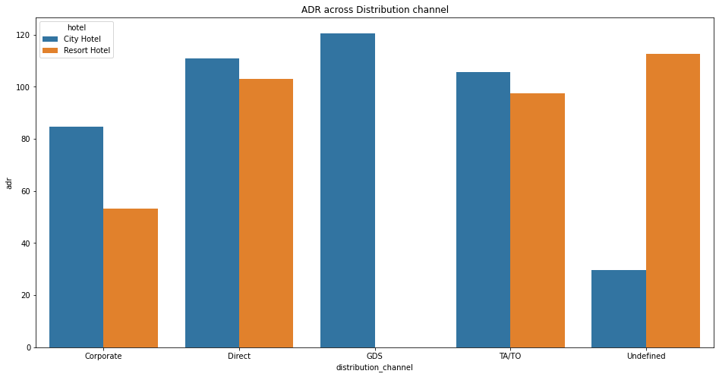
ADR (Across Distribution Channel)
A distribution channel represents a chain of businesses or intermediaries through which the final buyer purchases a good or service.

Slide 20
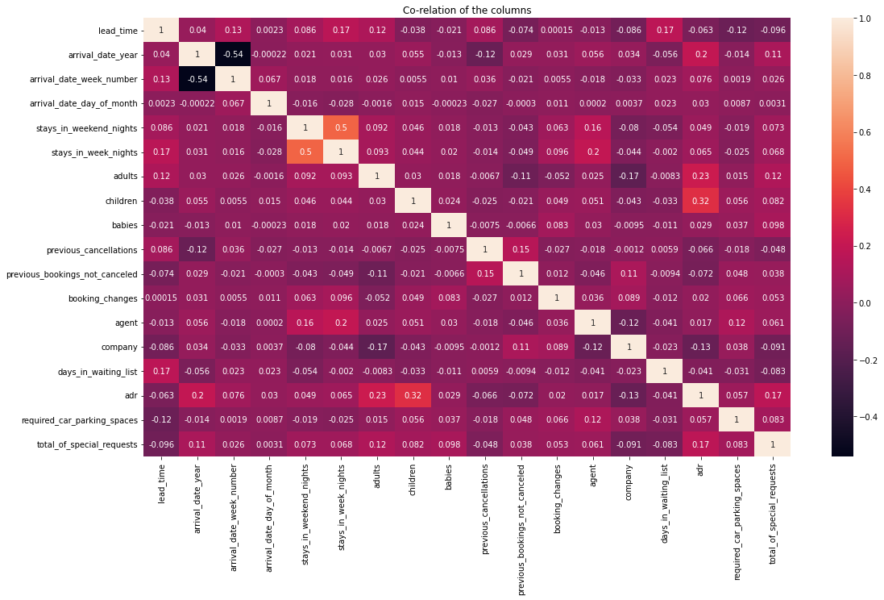
Correlation Heatmap
Correlation heatmaps are a type of plot that visualize the strength of relationships between numerical variables.

Slide 21
Conclusion
'City hotels' and 'Resort hotels' are two types of hotels present in the dataset, out of which, 'City hotels’ are more preferred by the customers than the latter. (66.4% customer prefers 'City hotels' whereas 33.6% customer prefers 'Resort hotels’)
Out of 119000 customer dataset, 75166 customers checked in hotel while 44224 customers cancelled their bookings, that is about 37% of the booking got cancelled whereas 63% customers checked in the hotel.
Majority of the deposit type is of 'No deposit' type, which itself concludes the high rate of cancellation rate.
From the given dataset, we can see 2016 is the year in which hotel bookings are the highest.
City hotels are of in high demand compared to resort in all aspects due to its reliability of majority of the population.

Slide 22
Online Travel agencies provides high amount of leads and customers following Offline TA, Groups, Direct, etc., So, we an conclude that we need to focus our marketing area on online TA since majority of the visitors tend to reach out to them
After analyzing the meal data, its found that 77.3% of customers prefers BB(Bed & Breakfast).
Most of the hotels have 0 to 1 car parking space.
Among the top 10 countries with respect to number of bookings, most of them are European countries which belongs to the list of which Portugal stands first with 48.5k bookings.
Its observed that average ADR is incrementing every year from 2015 to 2017, which clearly states that hotel business is scaling up every year.
Given that we do not have repeated guests, we should target our advertisement on guests to increase returning guests.

Slide 23
References
https://seaborn.pydata.org/
https://pandas.pydata.org/
https://matplotlib.org/
Geek for geeks
Almabetter Study Materials

Slide 24
Thank You

